Slide 1
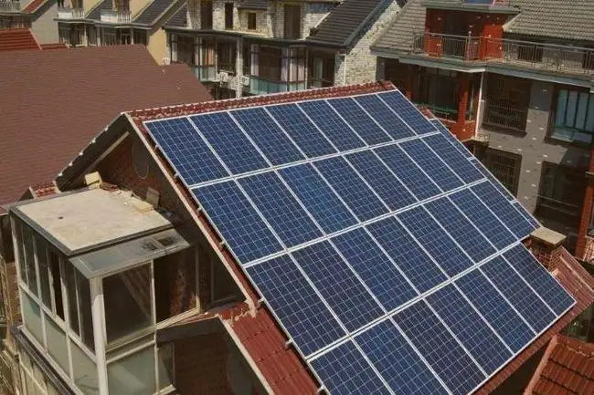

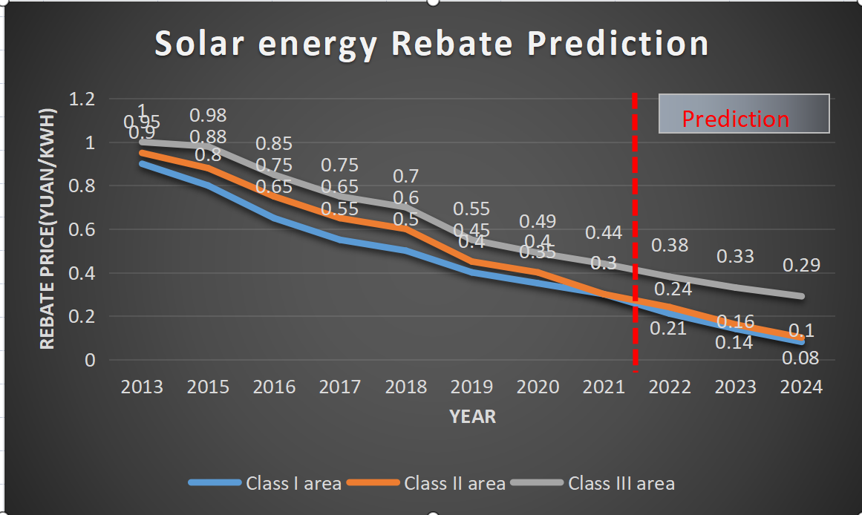

Solar Rebate Prediction Study in China areas
Group member:Jinyao Pu (1823549179@qq.com) Yuhao Lu(y327840386@163.com)
Professor: Majed Al-Ghandour (mnalgha@ncsu.edu)
PURPOSE
PRODUCT & RESULT
CONCLUSION
Study the prediction on the rebate (subsidy) of solar power generation in the next few years in various regions of the China, which can bring convenience and benefits to residents and promote the development of photovoltaic industry.
We can draw a conclusion from this table that the rebate price of solar energy will decline steadily in the next three years, and there is no significant difference in the downward trend of the rebate price in the three regions.
Task 1. Data Collection & Processing
Table3: Solar rebate in the next three years
PV rebate in China(focus on three types of resource areas,Class I area is Zhejiang Province,Class II area is Jiangsu Provice,Class III area is Anhui Province)
New increment of solar energy installation
According to the statistics of the national energy administration, the cost of photovoltaic power generation has decreased by about 90% since 2007
year | Class I | Class II | Class III
2022 | 0.21 | 0.24 | 0.38
2023 | 0.14 | 0.16 | 0.33
2024 | 0.08 | 0.1 | 0.29
INTRODUCTION
Family photovoltaic power generation enjoys the price rebate(RMB) given by the state to distributed PV power generation. With the increasing popularity of PV, more and more PV facilities will be incorporated into the power grid. From 2013 to 2020, the rebate of PV decrease year by year
FUTURE
(1)Collect more precise and regional solar rebate data.
(2)Find the data on the basis of the solar rebate price.
(3)Accurately predict solar rebate with advanced models.
Task 2. Time Series Analysis Model
In recent years, the rebate price of solar energy has dropped regularly according to time. Through the level ratio test of the data, all the level ratios of the translated sequence are within the interval (0.801, 1.249), indicating that the translated sequence is suitable for building a Gray Prediction Model.
Model Building
METHODOLOGY
Collect PV installed capacity data and PV rebate(RMB) data from different areas.
Choose the suitable time series analysis model.
Through the level ratio test,we find the Gray Prediction Model is suitable for the datasets then apply it to forecast the solar energy rebate prediction.
Development coefficient (a) | Grey action (b) | Posterior error ratio C value
0.135 | 1.184 | 0.011
REFENERCE
[1]https://www.china5e.com/index.php?m=search&c=index&a=adv_search_spe&typeid=&siteid=&q=%E5%85%89%E4%BC%8F%E5%B9%B6%E7%BD%91
[2]http://www.stats.gov.cn/tjsj/
[3]https://www.singfosolar.com/articles/pdzgty.html
Task 3. Trend on Rebate Analysis
Figure3:prediction result
With the popularization of photovoltaic power generation, we can draw a conclusion from the data in the three charts that the installation cost of solar energy will continue to decrease, and the corresponding total amount of new solar energy installation will continue to increase. With the continuous and rapid development of the photovoltaic industry, it is reasonable to reduce the photovoltaic subsidies correspondingly. The photovoltaic rebate policy has a very important contribution to promoting the development of the solar energy industry.

